Slide 1
GIFTED & TALENTED
Information Session
GREENVILLE ISD
What is Gifted and Talented (GT)?
How are GT students identified?
What GT services are available in GISD?

Slide 2
What is Gifted and Talented?
Program goals, identification procedures, and curriculum for Greenville ISD’s GT program are based on the definition of gifted/talented students taken from the Texas Education Code and the Texas State Plan for The Education of Gifted/Talented Students.

Slide 3
Definition of Gifted and Talented
§29.121 “gifted and talented students” means a child or youth who performs at or shows the potential for performing at a remarkably high level of accomplishment when compared to others of the same age, experience, or environment and who:
(1) exhibits high performance capability in an intellectual, creative, or artistic area;
(2) possesses an unusual capacity for leadership; or
(3) excels in a specific academic field.
Notes:
There is always considerable confusion between a BRIGHT student and a GIFTED learner, so I want to talk a little about that first.

Slide 4
BRIGHT versus Gifted Students
Wendy Writer
Ronny Reader
Abby Author
Berry Books
Is interested & attentive
Generates advanced ideas
Works hard to achieve
Performs at the top of the group
Learns with ease
6-8 Repetitions to mastery
Comprehends at a high level
Enjoys same age peers
Understands complex humor
Completes work on time
Is receptive
Is accurate and complete
Enjoys school
Absorbs information
Remembers the answers
Memorizes well
Is highly alert and observant
Is pleased with own learning
Gets As
Answers questions in detail
Notes:
Let's look at some characteristics that are considered by experts to represent BRIGHT, above average students. Teachers love having these students in their class. These students are eager to learn and eat up everything the teacher has to offer. They may even come to the teacher and want to learn more. They listen and complete work exactly how and when it is requested. They are at the top of the class and benefitting from general classroom instruction to its fullest potential.

Slide 5
Bright versus GIFTED Students
Annie Abstract
Tommy Thinker
Sandi Self-Taught
Paul Possible
Is selectively mentally engaged
Generates complex/abstract ideas
Knows without effort
Is beyond the group
Questions…”What if”
1-3 Repetitions to mastery
Questions the need for mastery
Poses unforeseen questions
Initiates project extension ideas
Prefers intellectual company or to be alone
Is intense/unconventional
Is original and developing
Enjoys self-directed learning
Improvises information
Creates complex/abstract humor
Infers/creates/brainstorms well
Anticipates, is intuitive
Is self-critical, never finished
May not be motivated by grades
Injects new possibilities and multiple perspectives
Notes:
Now lets look at GIFTED student characteristics. These students represent a challenge for the teacher in the classroom. They already know what is being taught, so they don’t need the teacher. If they want to know more, they go look it up themselves. They may be bored with the regular classroom curriculum, so they don’t pay attention and daydream. Or they may create trouble for themselves or others. They may argue with the teacher over work expectations or be overly sensitive to any criticism. They may quickly complete assigned work and constantly need more to do, or they may question the need to do the work at all, since they already know it. Overall, they are not truly benefiting from general classroom instruction. That is why the state mandates 30 hours of Foundation training for GT teachers and specific services be provided for identified students.

Slide 6
How are GT Students Identified?
GT identification procedures provide students an opportunity to demonstrate their diverse talents and abilities. Criteria to identify students for GT services is aligned to the state definition and is equitable for students of all populations.
The purpose of assessment is to identify students who would benefit from gifted program services.
Notes:
The primary goal is to paint a full picture of the students abilities across multiple areas, subjects, and grade levels– NOT just take a one-time test score/snapshot. That is why the Texas State Plan requires the collection of data from multiple sources and a committee of members to review the data and make recommendations.

Slide 7
Identification and Selection Process
The State Plan offers the following guidance:
2.15 “Assessment opportunities for gifted/talented identification are made available to students at least once per school year.”
2.16 “Students in grades K-12 shall be assessed and, if identified, provided gifted/talented services (TEC §29.122 and 19 TAC §89.1(2)).”
2.17 “Data collected from multiple sources for each area of giftedness served by the district are included in the assessment process for gifted/talented services (19 TAC §89.1(2)). The assessment process allows for student exceptionalities to the extent possible.”
2.20 “All kindergarten students are automatically considered for gifted/talented and other advanced level services.”
2.21 “At the kindergarten level, as many criteria as possible, and at least three (3) are used to assess students who perform at or show the potential of accomplishment relative to age peers.”
2.22 “In grades 1-12, qualitative and quantitative data are collected through three (3) or more measures and used to determine whether a student needs gifted/talented services.”
Notes:
The State does not specify what a “remarkably high level” is in their definition or in the Texas State Plan. However, most districts in Texas use the criteria of “at or above the 90th percentile rank compared to same age peers of similar background and experience.” Some districts criteria is set as high as the 95th percentile, and some go as low as the 85th percentile. Percentile rank is not the same as percent of items correct. Percentile rank indicates how well a student performed in comparison to the students in the specific norm group. <25% is considered below average 25%-75% is considered average, with 50% being statistically average. >75% is considered above average.

Slide 8
Referrals
2.15 “Assessment opportunities for gifted/talented identification are made available to students at least once per school year.”
The first phase of the GT identification process is the nomination of students, called a referral window. GISD accepts referrals from parents, community members, and teachers at all grade levels. Referrals are made in two groups, elementary (1st-3rd grade) and secondary (4th-12th grade.) Students referred during the window are place into a screening pool and parent permission to evaluate is obtained.
4th-12th Grade Referral Window: January 8-19th
1st-3rd Grade Referral Window: April 15-26th
Referral forms are available in every campus office and on the GISD website.

Slide 9
Kindergarten GT Screener
2.20 “All kindergarten students are automatically considered for gifted/talented and other advanced level services.”
All kindergarten students enrolled at the time of testing are included in the first stage of screening, usually in December. No referral or permission is needed since screening is universal. The assessment given is nonverbal and recommended for screening of both non-English/English speaking students and students identified with disabilities. Students scoring at or above the 75th percentile in an academic area are flagged to move on to the evaluation phase.
Once parent permission for further assessment is obtained, kindergarten student complete the rest of the GT evaluation procedures.

Slide 10
Evaluation Procedure
2.22 “In grades 1-12, qualitative and quantitative data are collected through 3 or more measures and used to determine whether a student needs gifted/talented services.”
Greenville ISD uses 5 formal measures and also considers classroom data when determining whether a student needs gifted/talented services. Students are given: a non-verbal cognitive test, academic tests in Reading and Math, and a formal creativity/divergent thinking assessment. During the GT evaluation, parents and teachers also complete a qualitative questionnaire about their student. Classroom data is collected and reviewed as well.

Slide 11
GT Selection Committee
Qualification Criteria for Greenville ISD:
At least one score in each
area in the 90th percentile
rank or higher.
Scores are placed on a matrix to allow the GT Selection committee to consider data from multiple sources.
Notes:
Our GT Selection committee includes: District GT Coordinator and all elementary GT Teachers. State guidelines require at least 3 members who have completed the state required GT training. Campus administrators and counselors may also serve on the committee if they have completed the state required GT training.

Slide 12
Appeal Procedure
A parent may appeal an identification decision by sending an appeal letter to the District G/T Coordinator. The appeal must be received within 10 business days of receipt of the GT committee’s initial decision. The committee will reconvene in order to consider the need for further assessment data or to consider other information that may be shared by the parent.
Notes:
Our GT Selection committee includes: District GT Coordinator and all elementary GT Teachers. State guidelines require at least 3 members who have completed the state required GT training. Campus administrators and counselors may also serve on the committee if they have completed the state required GT training.

Slide 13
Transfer Students
When a GT student in grades K-5 transfers into GISD from another district, the parent should notify the new campus that the was being served by the previous district. GT evaluation records will be requested from the previous district.
When that documentation is provided, the committee will meet to determine if the student meets GISD criteria for GT services or if additional testing is needed. The district will make the decision and notify the parents within 10 business days of receiving the GT evaluation records.
When a student in grades 6-12 transfers into GISD from another district, they may be placed in advanced level classes at parent request. Records will be reviewed when received and the student’s file will be updated once GT services are verified.

Slide 14
Furlough
Exit
A furlough is a temporary "leave of absence" from receiving GT services and is designed to meet the individual needs of an identified student. A student may be furloughed for a period of time not longer than one semester. At the end of the furlough, the student's progress shall be reassessed by the GT committee, and the student may resume services, exit from services, or be placed on another furlough.
For a variety of temporary circumstances that would interfere with a student’s performance or ability to benefit from GT services.
A student may be considered for exit from GT services if it is in their best interest and/or if GT services do not seem to be educationally appropriate for the student. The petition for exit may be initiated by request from the parent, student, teacher, or administrator.
Reasons for exit/withdrawal may include personal, educational, psychological, or social stresses that prevent student performance or participation. Each situation will be reviewed individually. (19 TAC 89.51 (a) and (e)).
Note: Once a student is exited, the student is subject to referral and identification to determine educational need for the program before readmission.
Notes:
During a furlough or prior to exiting services, a specific intervention plan may be developed to help a student in their particular area of need. Our goal is to support gifted students in such a way that encourages them to their full potential.
A note about Skyward: When a student is identified in Skyward with a GT code, that means the student is receiving GT services and this label is solely for PEIMS reporting purposes. If a student is on furlough, they are not receiving services and would not be identified as receiving services in Skyward (no GT label).

Slide 15
What GT Services are available in Greenville ISD?
According to the Texas State Plan, GT services are:
…services and activities not ordinarily provided by the school
that are specifically designed to fully develop the capabilities
of students who give evidence of high achievement or
capability in areas such as intellectual, creative, artistic, or
leadership capacity.

Slide 16
Texas State Goal for GT Students:
Students who participate in services designed for gifted students will demonstrate skills in self-directed learning, thinking, research, and communication as is evidenced by the development of innovative products and performances that reflect individuality and creativity and are advanced in relation to students of similar age, experience, and environment.
Notes:
Our program curriculum aligns with the Texas State goal for Gifted students, so let’s start there.

Slide 17
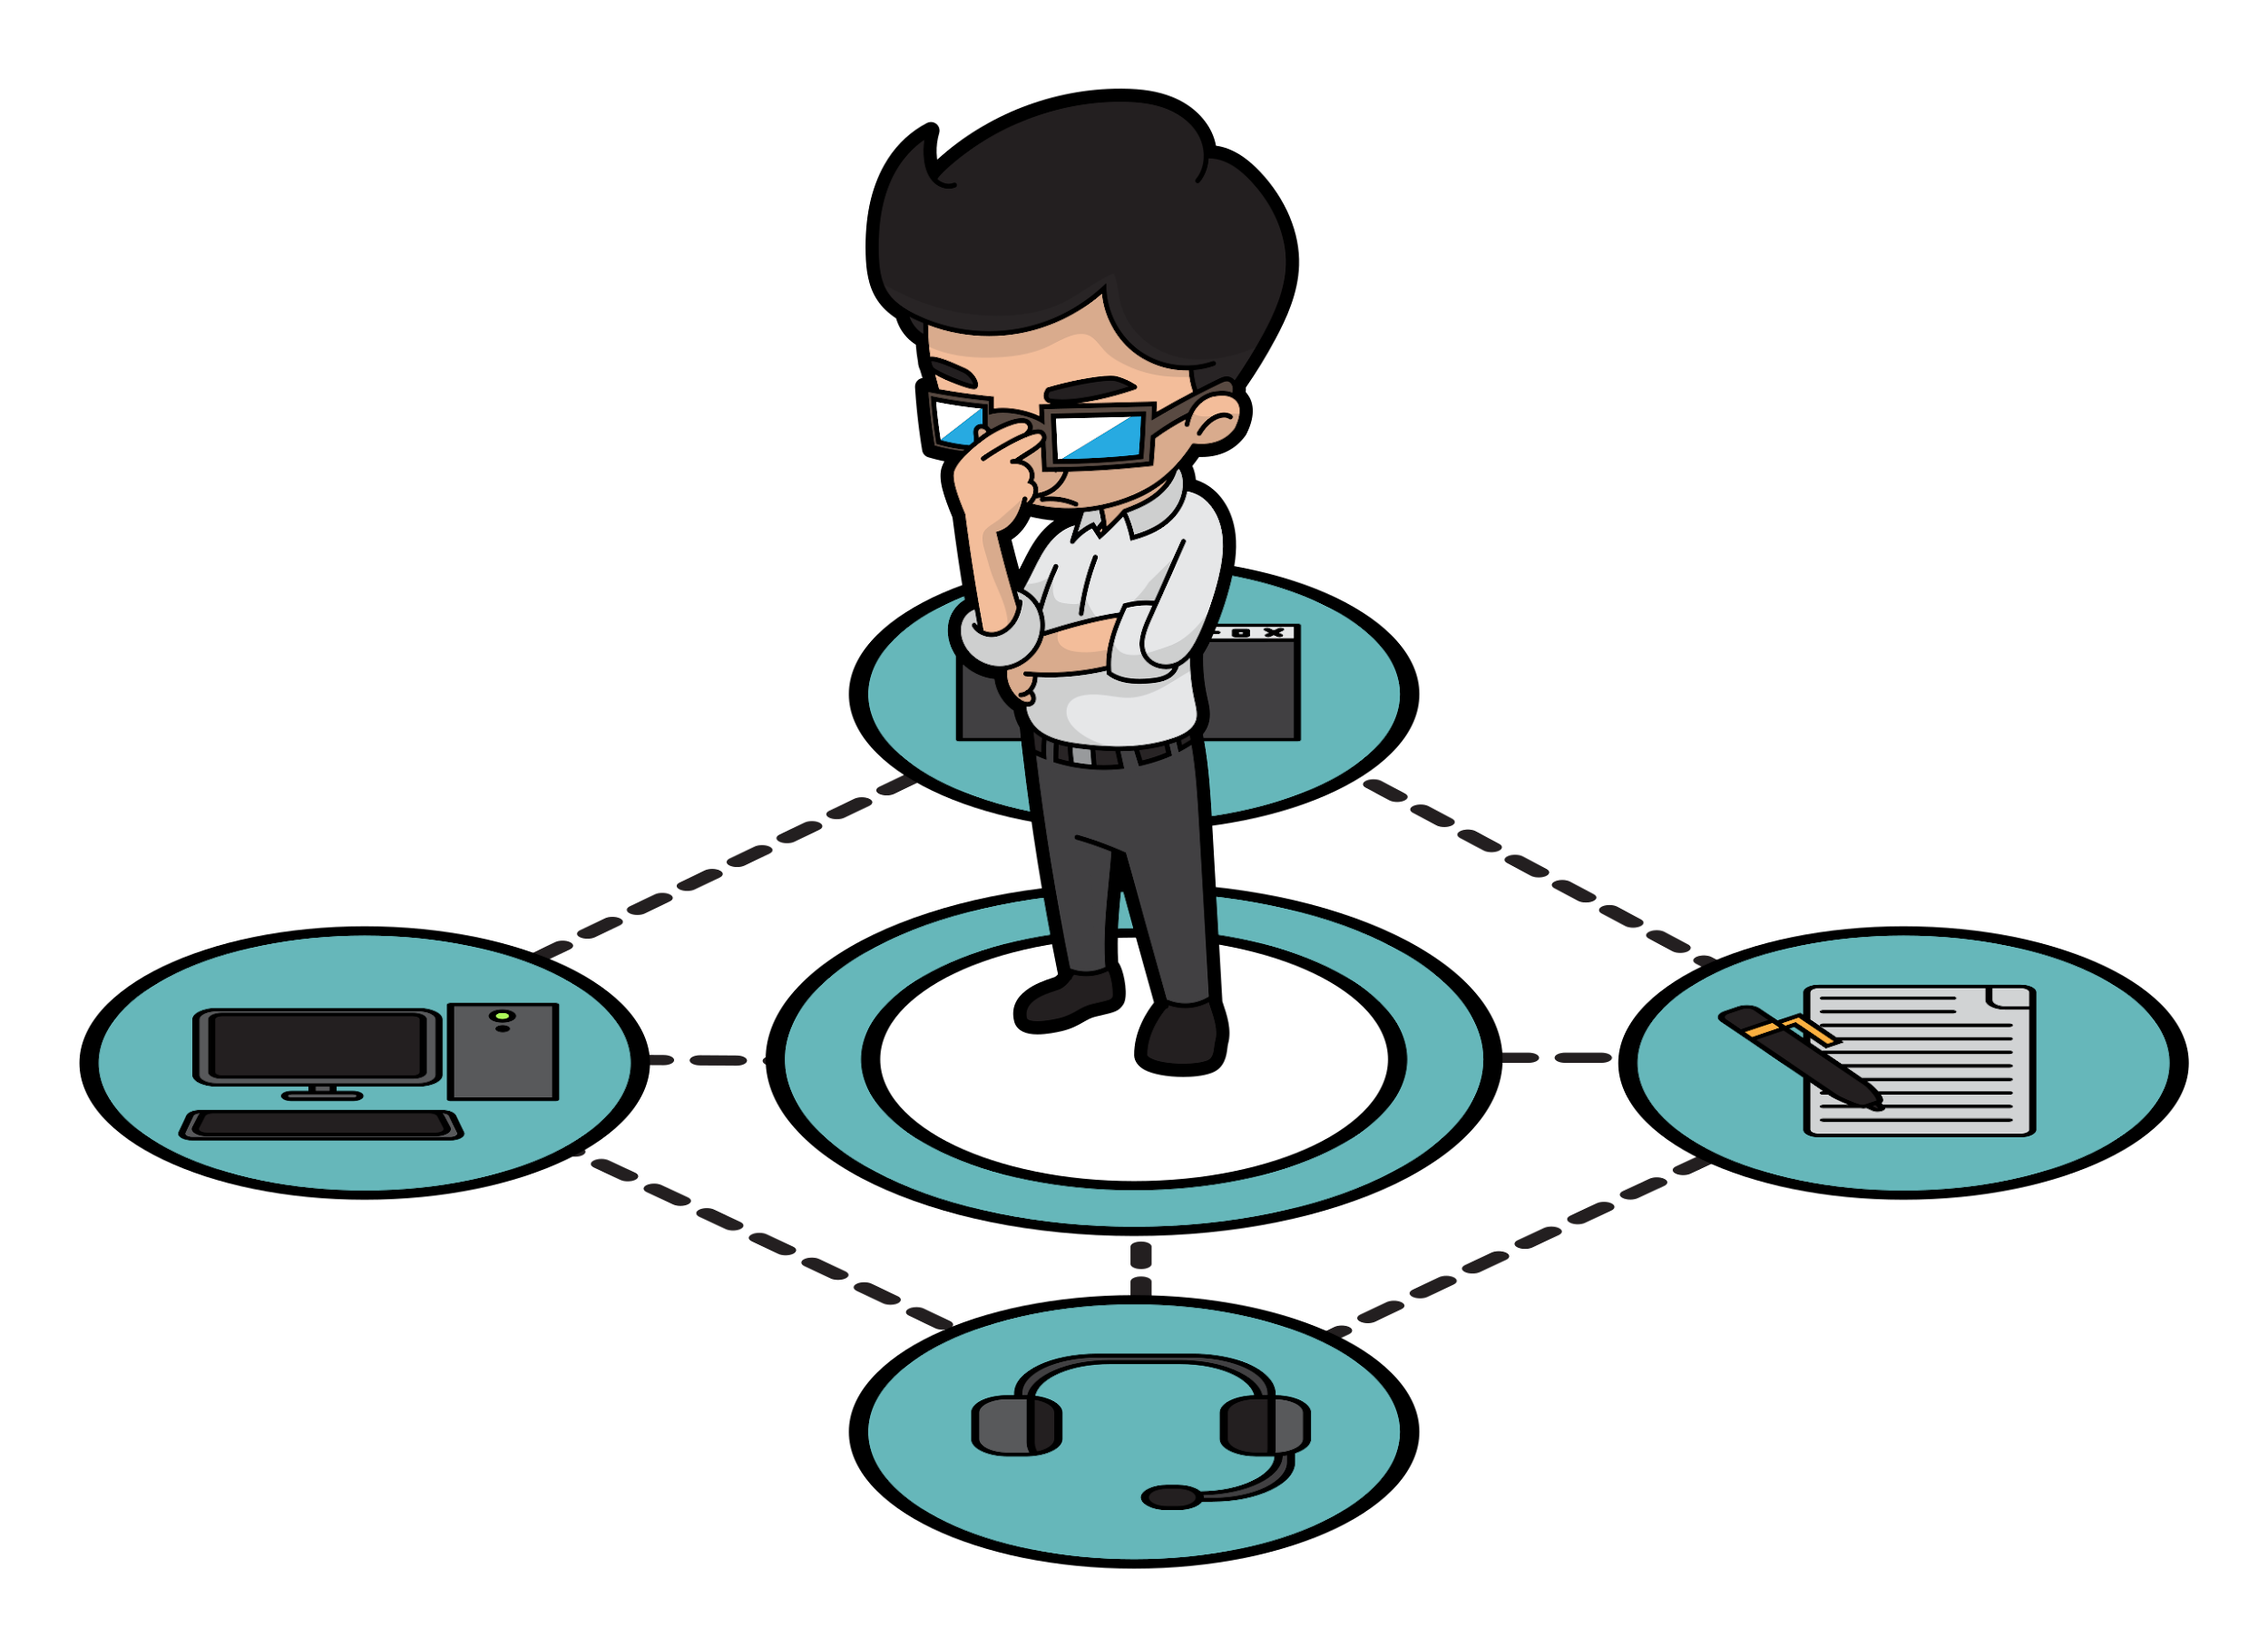
Secondary: Advanced Academics
Our secondary program allows for all students to enroll in advanced level classes. It is not necessary to qualify for the Gifted Program to participate in Advanced Academics via Honors, PreAP, AP, and dual-credit classes.
However, GT identified students MUST participate in at least one advanced level class to retain the coding for GT services in Skyward.
There are also many opportunities outside of Advanced Academics available to students who excel in
divergent thinking, leadership, and creativity. Opportunities include: Robotics, Destination Imagination,
UIL competitions, Suzuki Strings, ROTC, FFA, Theatre, Art, CTE, Choir, Band, Student Government, and athletics.
Notes:
All G/T Honors, PreAP, and AP classes in the four core content areas are taught by teachers with thirty hours of foundational GT training and a yearly update. Another note about Skyward, if a secondary student is not enrolled in any honors, Pre-AP, AP, or dual credit classes, they are not receiving GT services and would not be identified as receiving services in Skyward (no GT label). Many colleges are now required students unweighted GPA and so many families choose to enroll in all regular classes. This is an important discussion to have with your student and high school counselor before dropping the advanced classes.

Slide 18
GT Services at Elementary
Our elementary GT Program is a “pullout” program for K-4th grades. We use a GT curriculum that supports critical thinking, logic, problem solving, art, research, interdisciplinary, math, reading/language arts, science and social studies. The curriculum offers STEAM and self-directed learning opportunities for students.
In addition to adding depth and complexity to grade level curriculum, a key feature of our pullout program is to provide an opportunity for identified students to work and learn together. At smaller campuses, students may be grouped across grade levels to provide this opportunity.
Notes:
The State Plan provides several options for providing GT services, which can look different district to district. In addition to pull-out programs, there are push-in programs, student grouping models, and the option to have a separate school that only serves identified students (as seen in some larger school districts like Dallas, Mesquite, and Houston).

Slide 19
GT Services for Grades 1-4
The yearly theme rotates through different ancient civilizations.
Egypt & Africa
Greece
Rome
China
Middle Ages
The curriculum focus is different each weekday of GT services.
Monday- Math
Tuesday- Logic
Wed- Critical Thinking
Thursday- Theme Study
Friday- Novel Study/Projects

Slide 20
TPSP and GT Projects
The Texas Performance Standards Project (TPSP) provides a set of performance standards, curricula, and assessments for differentiating instruction and deepening academic learning.
PURPOSE: To capture the high levels of academic performance of GT students through independent research.
Animal Habitats Pursuit of Passion Create a Game/Toy Toothpick Bridges Paper Roller Coasters
Notes:
In Greenville, we use the TPSP and other projects to enrich students learning and as a stepping stone to achieving the Texas State Goal for GT Students: Students who participate in services designed for gifted students will demonstrate skills in self-directed learning, thinking, research, and communication as is evidenced by the development of innovative products and performances that reflect individuality and creativity and are advanced in relation to students of similar age, experience, and environment.

Slide 21
GT Services for Kindergarten
Identified kindergarten students begin receiving services 1-2 times per week during the last RP, typically after spring break.
Kindergarten students participate in a specific curriculum “Thinking Hats,” which is designed to stimulate their problem-solving, critical thinking, and creativity.

Slide 22
GT Contact
Information
District Gifted and Talented Contact
Jacklynn Fulp fulpj@greenvilleisd.com
Director of Instructional Programs (504, GT, 504 Dyslexia)
903-408-4479
Campus GT Contacts:
Bowie:
Samantha Boggs boggss@greenvilleisd.com
Crockett/KGJ/Travis:
Jennifer Mitchell mitchellj@greenvilleisd.com
Carver:
Alexi Quintero quinteroa@greenvilleisd.com
Lamar:
Kelly Walker walkerk@greenvilleisd.com
Helpful Links:
Greenville ISD GT Website
TEA GT Website
The Texas Performance Standards Project
Texas Association for Gifted and Talented
National Association for Gifted Children

